Slide 1

ITI-Examination System
Ahmed Saber
Abanoub Ibrahim
Amr Abdel-Gawad
Heba Amgd
Asmaa Abdel-Mohsen

Slide 2





Our Team
Ahmed Saber
Asmaa Abdel-Mohsen
Abanoub Ibrahim
Heba Amgd
Amr Abdel-Gawad

Slide 3
AGENDA
Project Overview
Database - ERD - ENTITIES & RELATIONSHIPS - MAPPING - Data Preparation - Stored Procedures
Reports
ETL & Modelling
Dashboard

Slide 4

PROJECT OVERVIEW

Slide 5
PROJECT OBJECTIVE
Developing An Efficient And Comprehensive Examination
Automate The Entire Examination Process For ITI
Developing Status Analysis Dashboards To Track The Overall Performance

Slide 6
KEY FEATRURES
Store Information About Students, Tracks, Branches, And Instructors.
Generate Exams Using The Question Bank.
Record Examination Results.
Streamline And Centralize The Examination Process.

Slide 7
Implementation life cycle
ERD and Mapping
01
02
Database Design
Tableau
06
03
Data Extraction
05
Power BI
04
SSRS

Slide 8

DATABASE

Slide 9
ENTITIES
STUDENT
DEPARTMENT
EXAM
TOPIC
COURSE
COMPANY
BRANCH
INSTRUCTOR
QUESTION
PROJECT
FREELANCING
CERTIFICATES

Slide 10
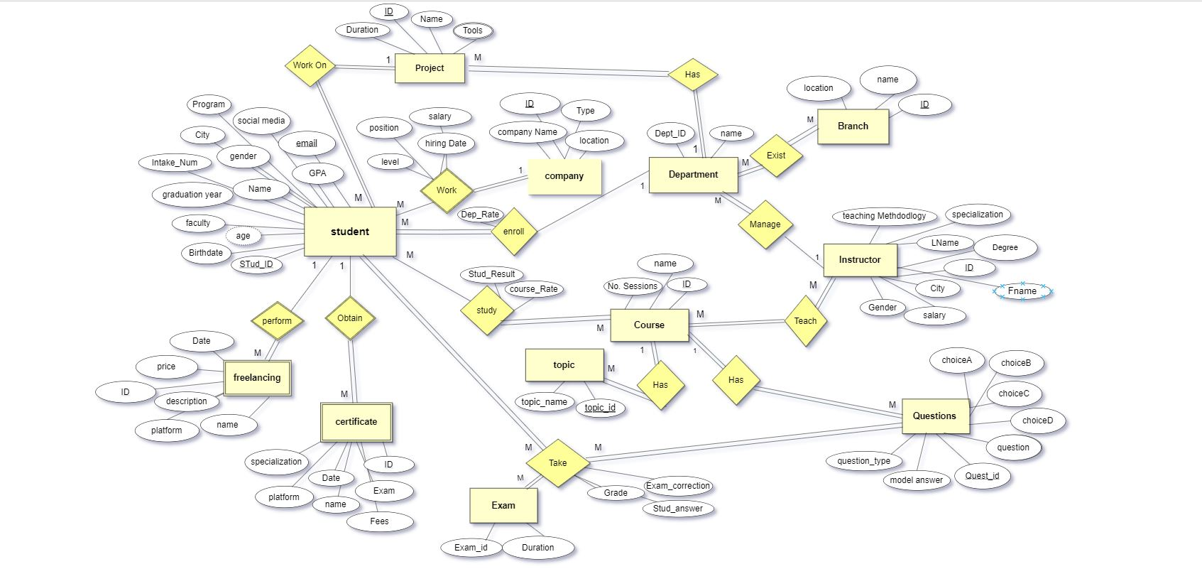
ER Diagram

Slide 11
RELATIONSHIPS
A department must exist in one or more branches, and a branch must contain one or more department
Each student must be enrolled in only one department, and a department can contain many students.
Each instructor must teach one or more courses and each course must be taught by one or more instructors.
A course contains several topics, and a topic can only exist in one course.
A student must take more than one certificate and do one freelancing.
Each certificate can only be accomplished by one student

Slide 12
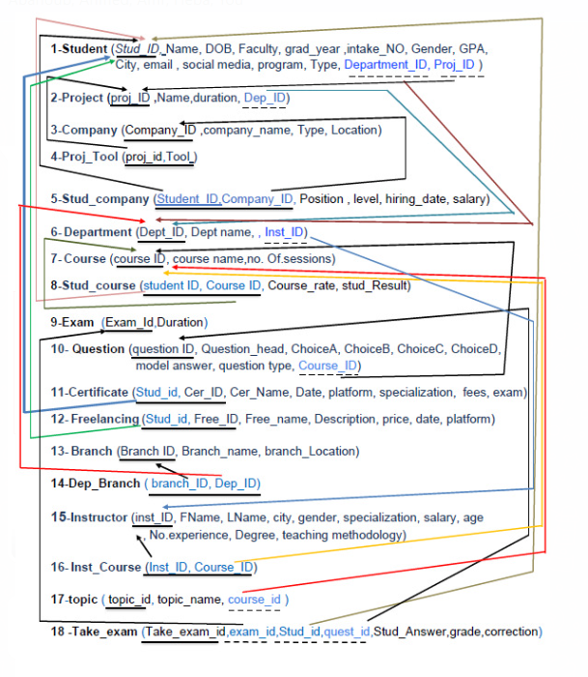
MAPPING

Slide 13
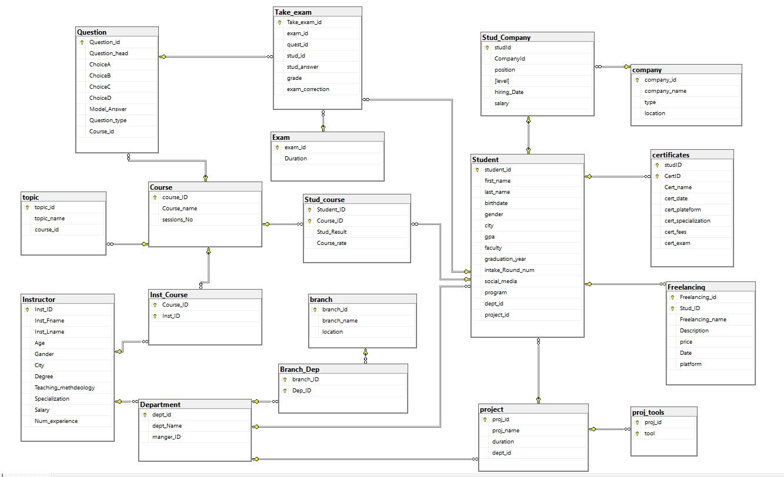
DATABASE SCEHMA

Slide 14


DATA PREPARATION
Using Excel And Mockaroo To Prepare Random Data To Be Integrated Together
To Maintain Data Integrity, There Were Some Conditions To Follow While Randomizing Data

Slide 15
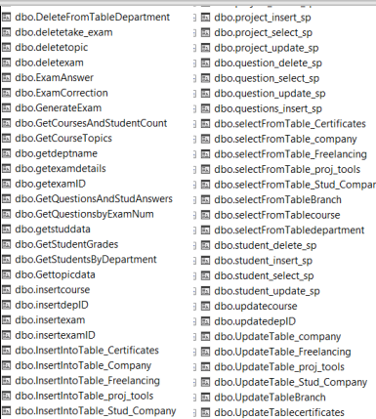
Stored Procedures
Created stored procedures
SELECT FROM TABLES (GENERALIZED)
INSERT FROM TABLES (GENERALIZED)
UPDATE TABLES (GENERALIZED)
DELETE FROM TABLES (GENERALIZED)
EXAM GENERATION PROCEDURE
EXAM ANSWER PROCEDURE
EXAM CORRECTION PROCEDURE

Slide 16
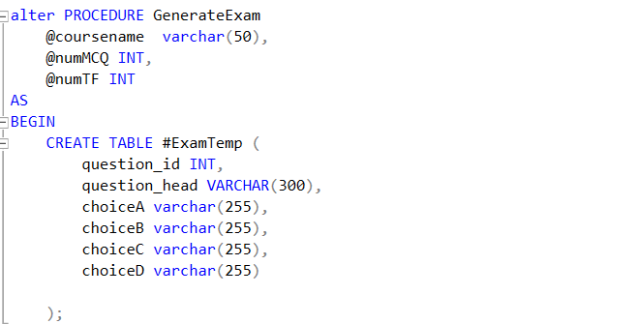
EXAM GENERATION PROCEDURE

Slide 17
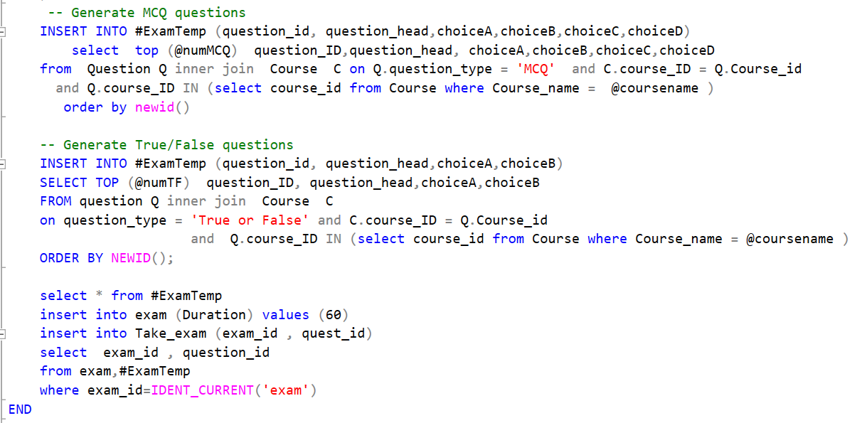
EXAM GENERATION PROCEDURE

Slide 18
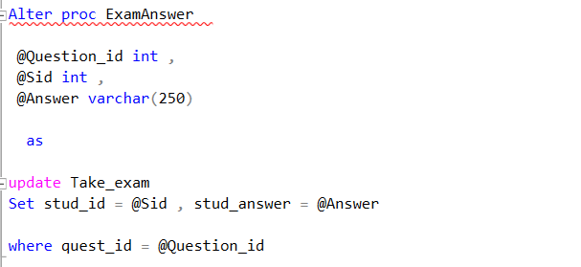
EXAM ANSWER PROCEDURE

Slide 19
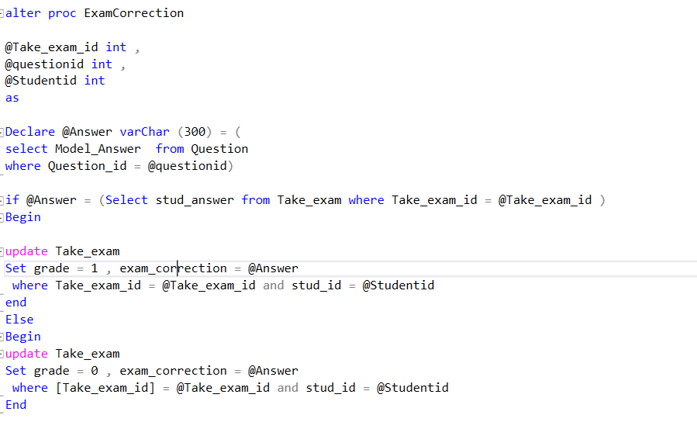
EXAM CORRECTION PROCEDURE

Slide 20

SSRS - REPORTS

Slide 21
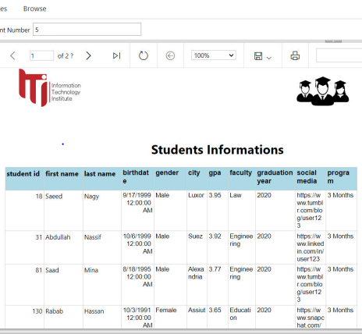
STUDENT INFORMATION REPORT

Slide 22
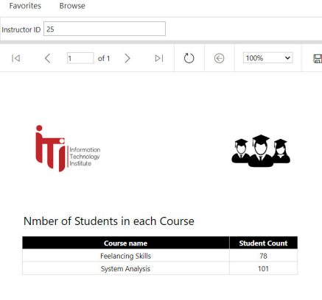
NUMBER OF STUDENTS IN EACH COURSE

Slide 23
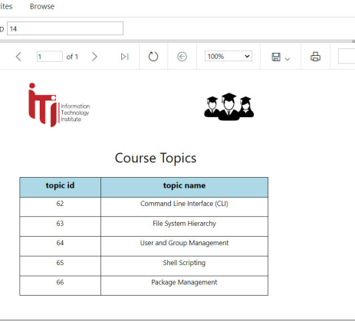
COURSE TOPICS

Slide 24
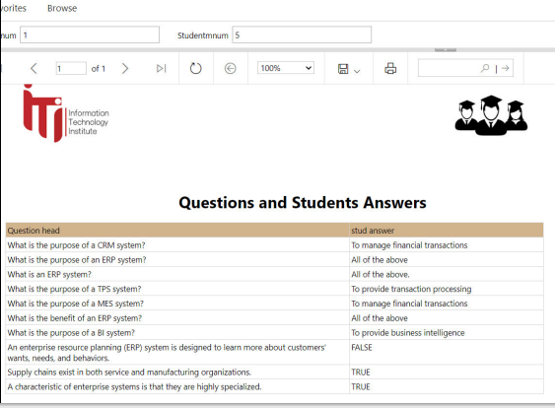
QUEST. & STUDENT ANSWERS

Slide 25
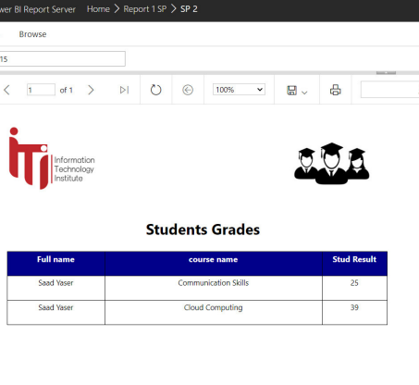
STUDENT GRADES

Slide 26
ETL & MODELING

Slide 27
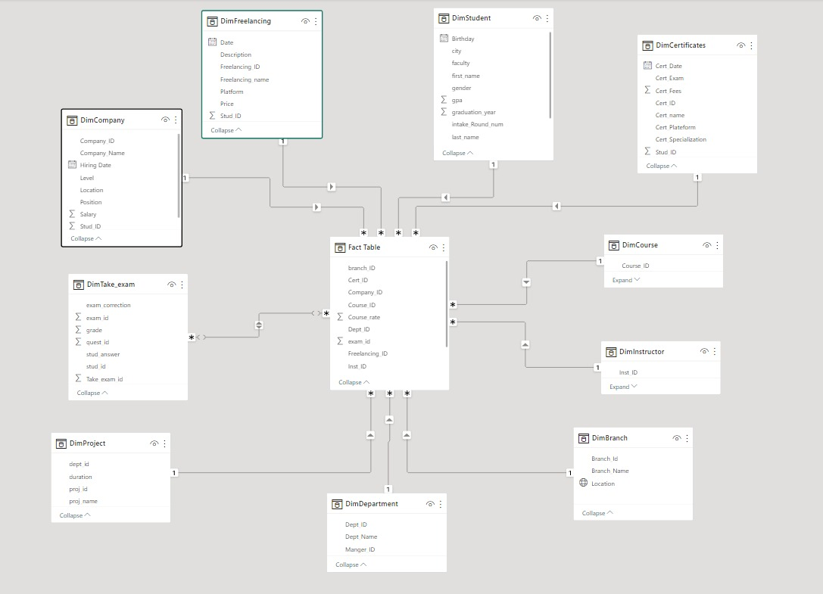
Power BI Model

Slide 28

Power BI DASHBOARDS

Slide 29
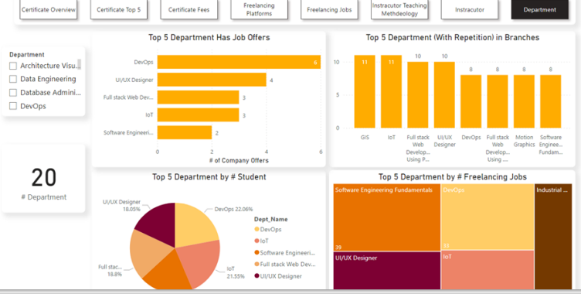
Department Dashboard

Slide 30
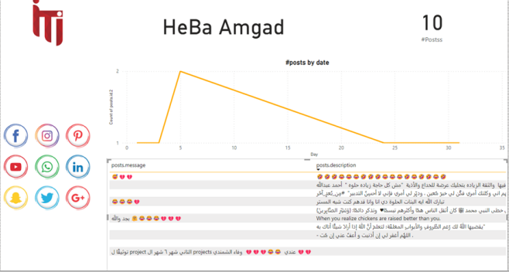
API Dashboard

Slide 31
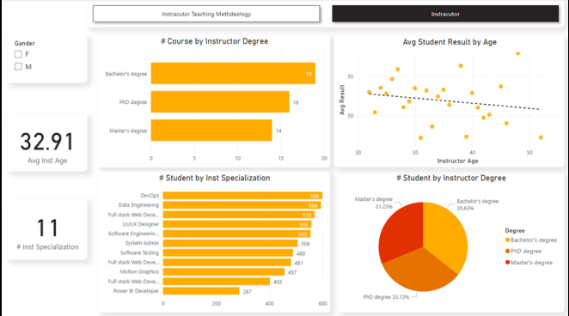
Instructors Performance Dashboard

Slide 32
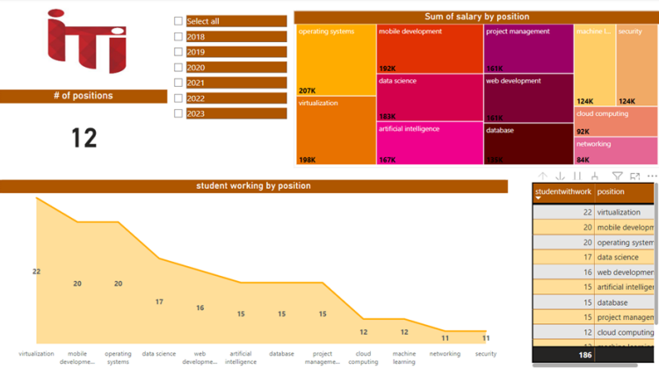
Student Company Dashboard

Slide 33
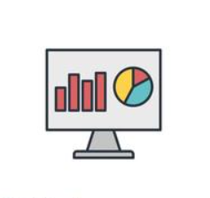
TABLEAU DASHBOARDS

Slide 34
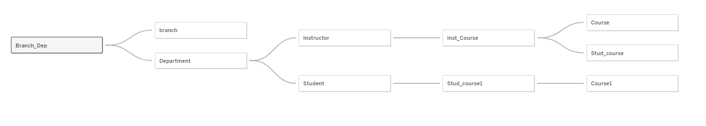
TABLEAU MODEL

Slide 35
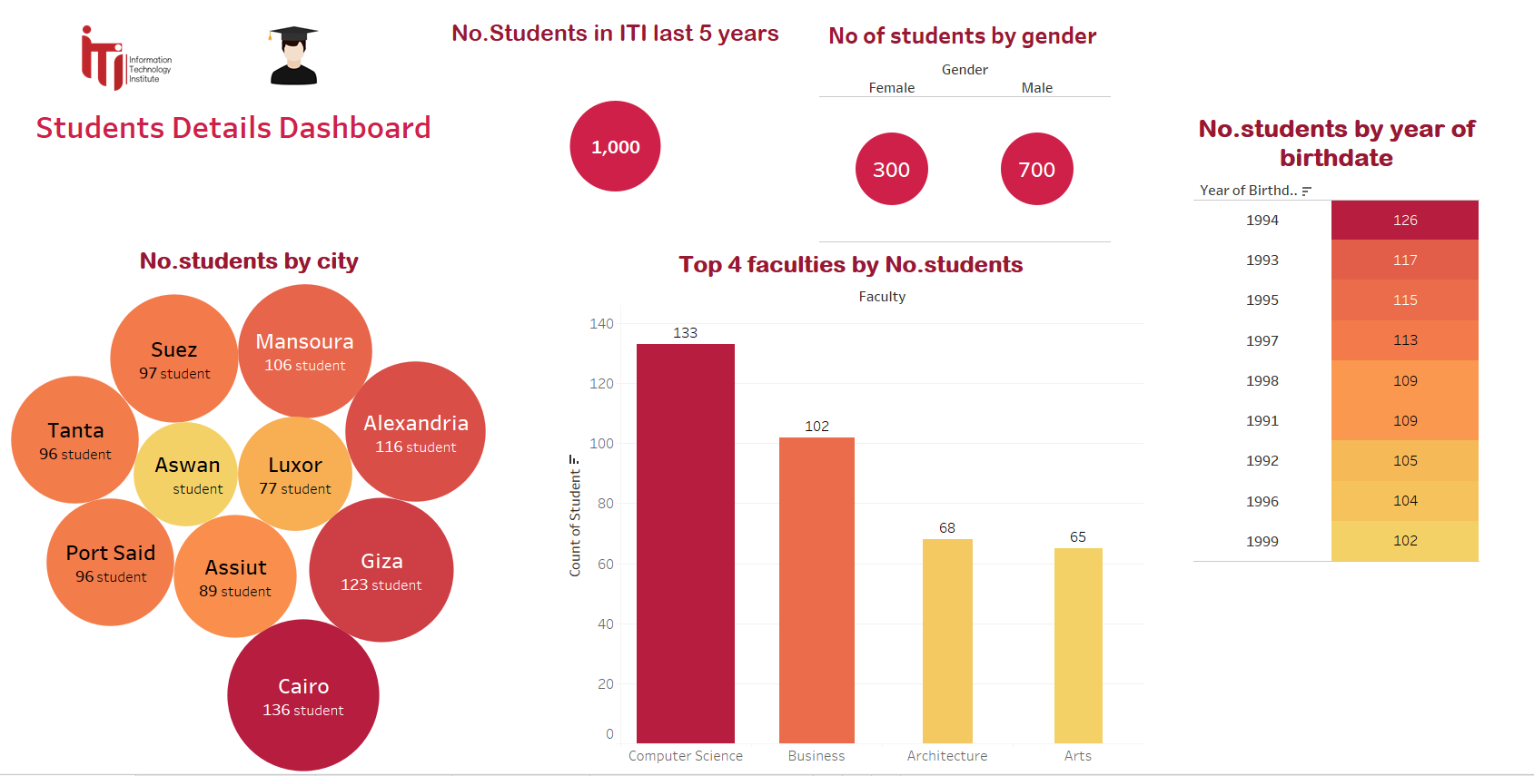
Students Overview Dashboard

Slide 36
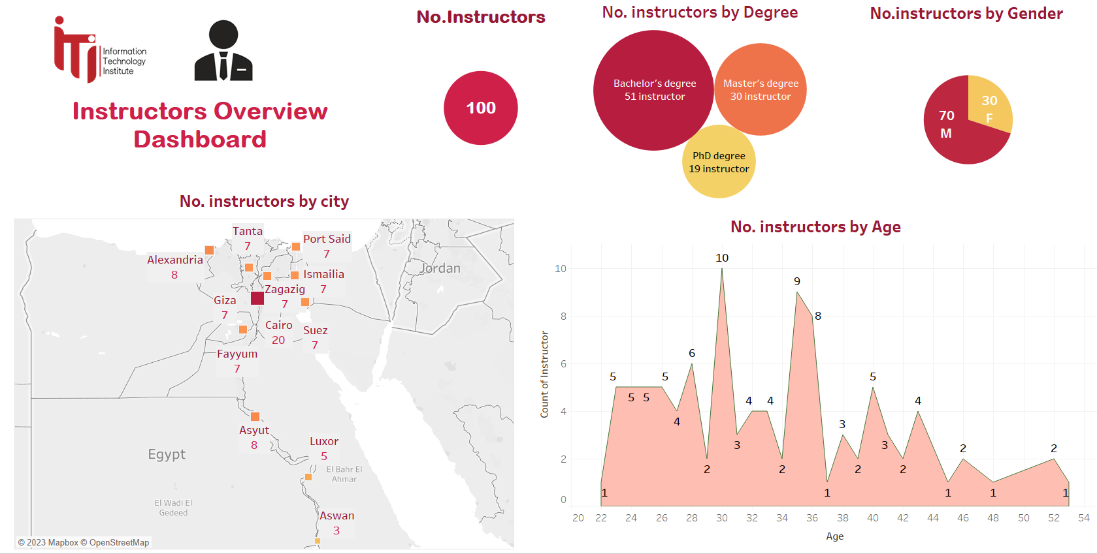
Instructors Overview Dashboard

Slide 37
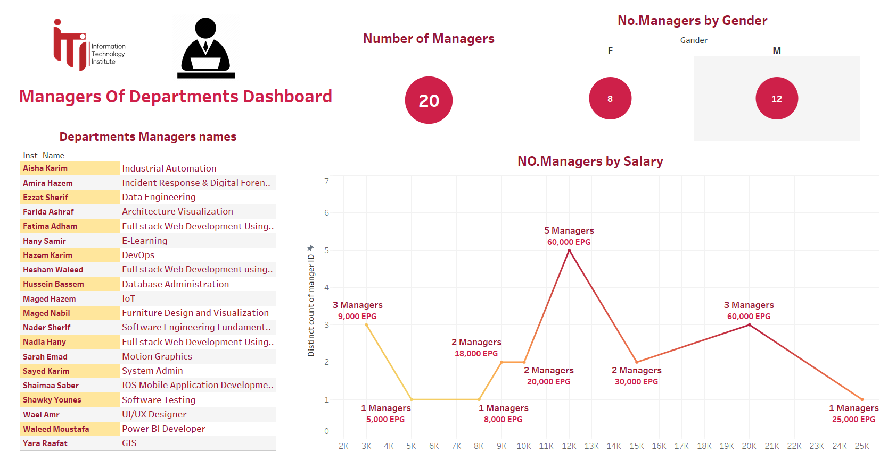
Managers of Departments Dashboard

Slide 38
THANK YOU

